Slide 1
Power and Performance comparison of face recognition solutions
Draft version
Author/Email: Vladimir Stepanov / vladimmir.stepannov@harman.com
Version: 1.3(170717)

Slide 2
Comparison requirements
Goals
Compare top popular open source or closed source solutions in their performance, robustness and accuracy
Deliverables
A source code repository that contains popular solutions for the algorithms being compared
A data sheet that contains the comparison for core algorithms in performance, robustness and accuracy

Slide 3
Features and Core Algorithms are compared
Face detection
Google GMS Vision Face Detector
CFAN Face Detection in SeetaFace
HAAR Cascade Classifier (OpenCV)
LBP Cascade Classifier (OpenCV)
Face Alignment
Google GMS Vision Landmark API.
Shape predictor in DLIB (partially uses OpenCV library)
CFAN Face Alignment in Seetaface
DLIB + LBP Enhanced face detection

Slide 4
Android application for comparison
To compare all features and algorithms, all of them were integrated and implemented in one test application.
Full source code of app is placed at: https://git.hios.fi/tsaikka/facemask-test
Pre-build apk-file and test data are at: https://git.hios.fi/tsaikka/facemask-deliveries
Test application uses next sources of test data:
Camera (Front and Back camera can be selected at runtime)
Set of 500 test images (250 x 250 px)
Test video file (Portrait mode)
Test app has following capabilities:
Select frame size for recognition at runtime
Set brightness and contrast of frame
Some screenshots are shown on the next slide

Slide 5
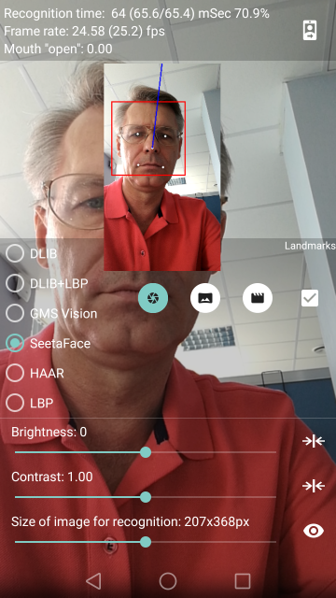
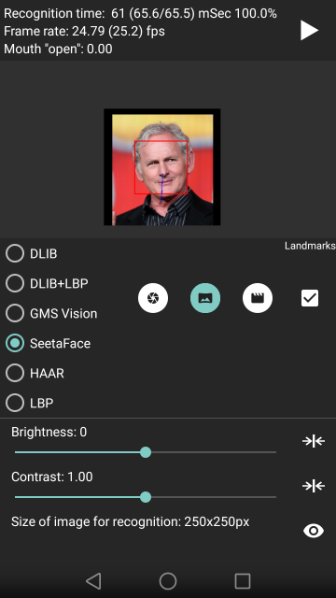
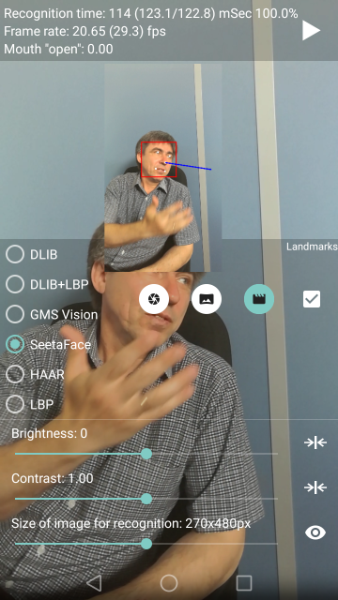
Screenshots of the Test Application

Slide 6
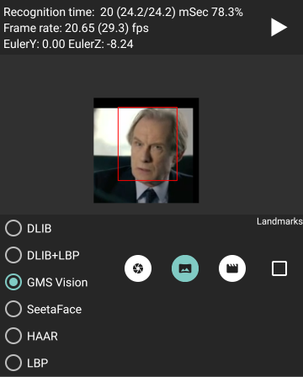
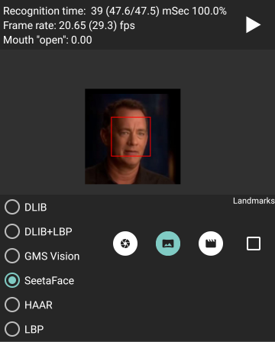
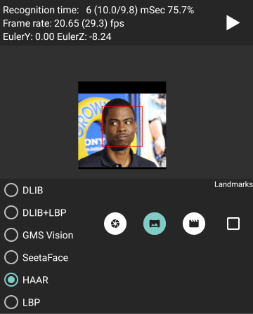
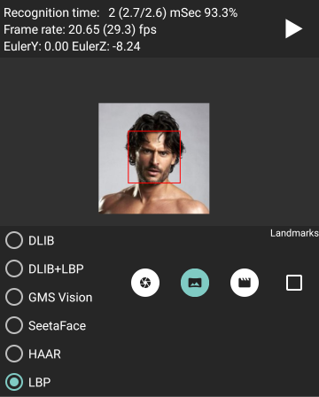
Face detection features comparison
Set of test images
For each face detectors (GMS Vision, HAAR and LBP) all three data sources were used.
The simplest test is with set of test data images (500 images), where each image is .png file with size 250 x 250 pixels. Here are some samples of test images with face detection. The first one is for Google GMS Vision without landmarks detection, the second one is for SeetaFace face detector, third - HAAR Cascade Classifier, and the last one – LBP Cascade Classifier. The results of measurement for set of images is shown on the next slide.

Slide 7
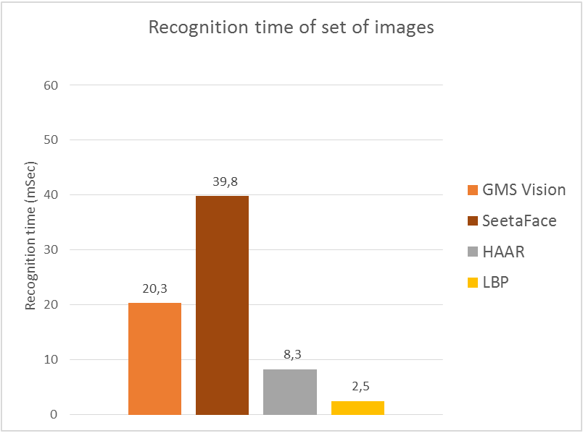
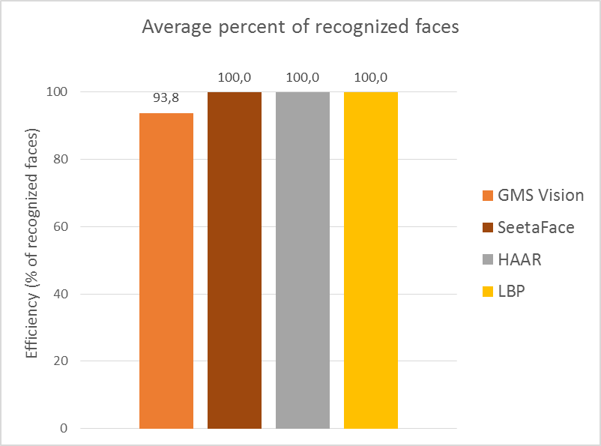
Face Detection features comparison
Set of test images: Latency and Accuracy

Slide 8
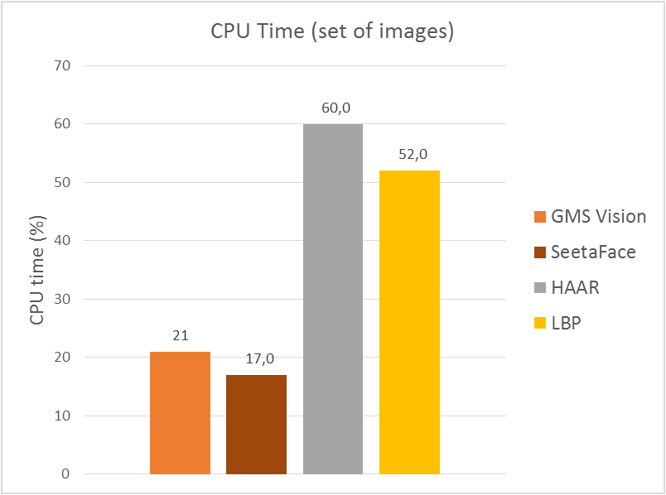
Face Detection features comparison
Set of test images: CPU Consumption
The following diagram shows CPU Time of Test Application for set of 500 test images

Slide 9
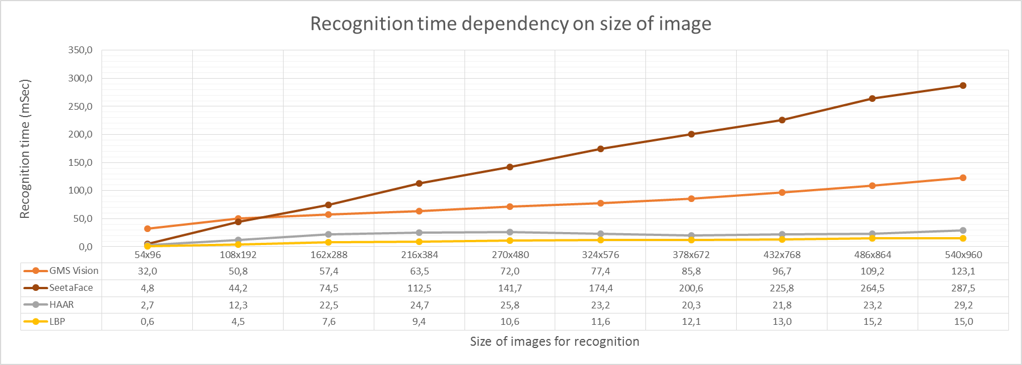
Face Detection features comparison
Test video file: Latency
For video files we have not to compare detectors only, but we have to check if there are any dependencies on image size. So, here are diagram shows this dependency.

Slide 10
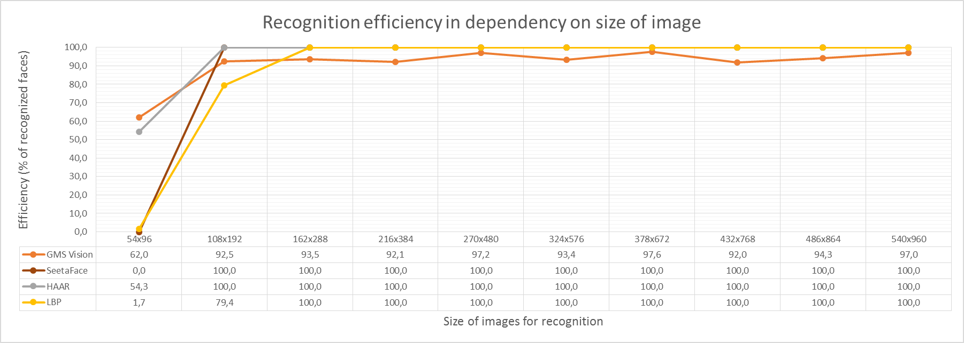
Face Detection features comparison
Test video file: Accuracy
Also not all detectors shows the same accuracy on the same set of images.
As example, GMS Vision does not detect 100% of faces as HAAR and LBP.

Slide 11
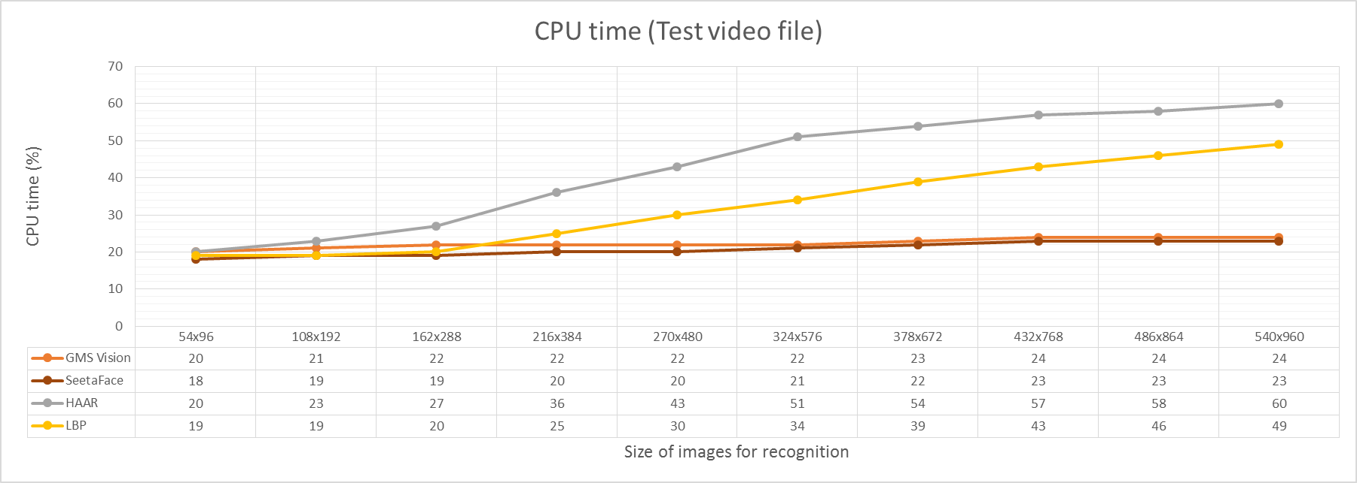
Face Detection features comparison
Test video file: CPU Consumption
The following diagram shows CPU Time of Test Application for test video file and different frame sizes

Slide 12
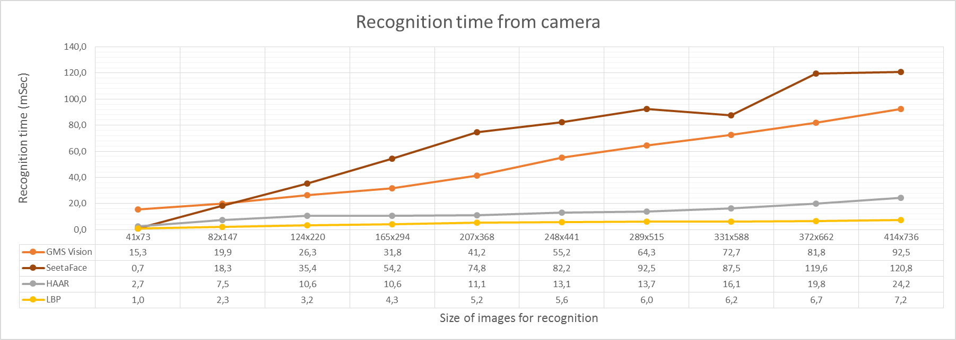
Face Detection features comparison
Frontal camera: Latency
It is very hard to make identical conditions for measurements while camera is used. So, the following diagram is just for visual comparison of face detection time.

Slide 13
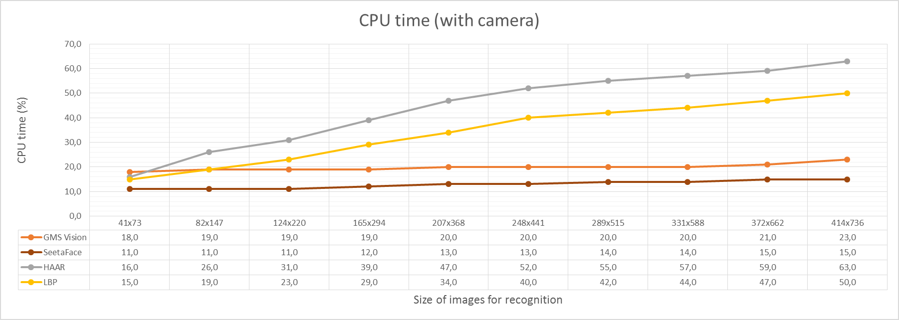
Face Detection features comparison
Frontal camera: CPU Consumption
The following diagram shows CPU Time of Test Application for different sizes of frames

Slide 14
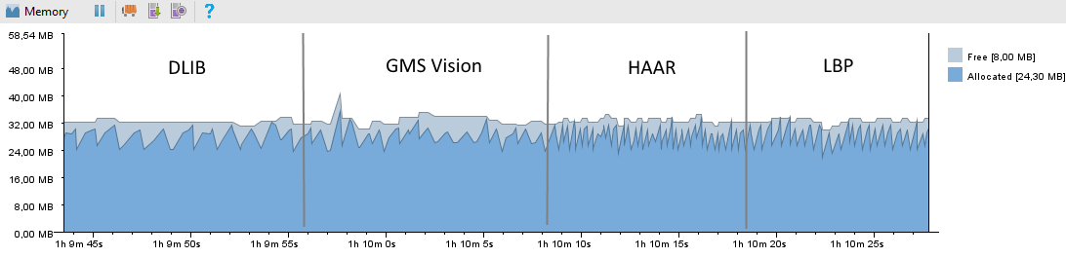
Face Detection features comparison
GPU Consumption
No one algorithm uses GPU directly for face recognition.
Memory Consumption
There are no sufficient differences between face detectors, because the largest amount of memory consumes processing of image, and not face detectors themselves.

Slide 15
Face Detection features comparison
Power Consumption
There are no ways to measure power consumptions without specific device – Power Monitor and “Fake” battery.

Slide 16
Face Alignment features comparison
There are the same data sources are used as for Face Detection
Set of test images (500 png-files 250x250 pixels)
Test video file
Frontal camera just for demo

Slide 17
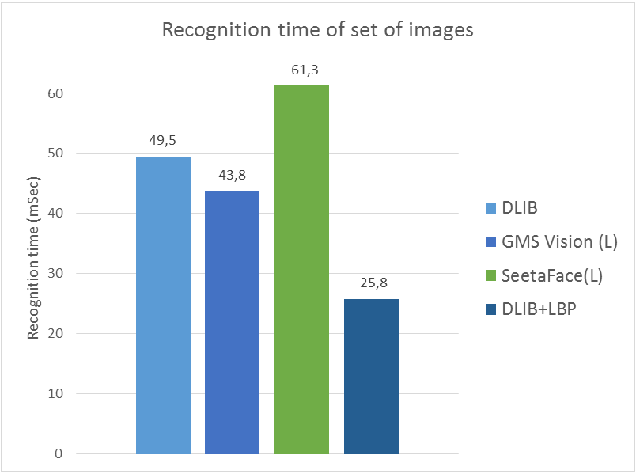
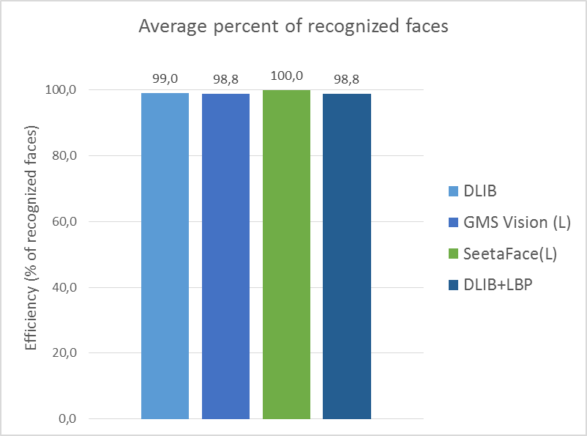
Face Alignment features comparison
Set of test images: Latency and Accuracy

Slide 18
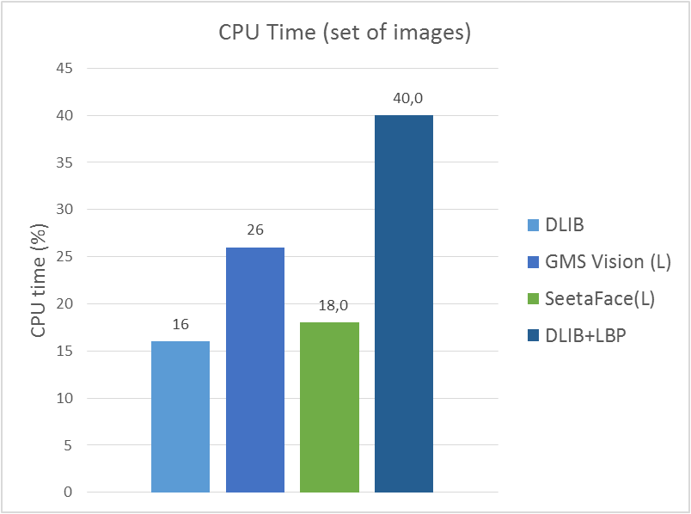
Face Alignment features comparison
Set of test images: CPU Consumption
The following diagram shows CPU Time of Test Application for set of 500 test images

Slide 19
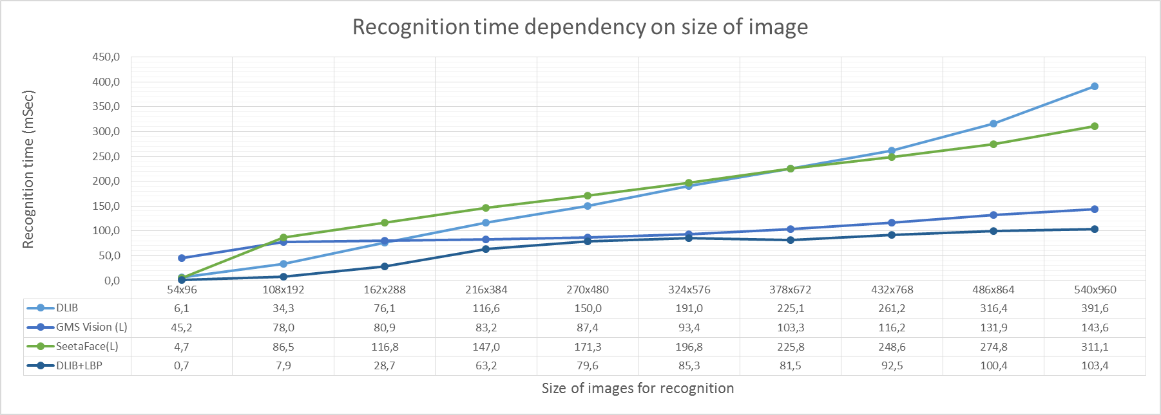
Face Alignment features comparison
Test video file: Latency
For video files we have not to compare detectors only, but we have to check if there are any dependencies on image size. So, here are diagram shows this dependency.

Slide 20
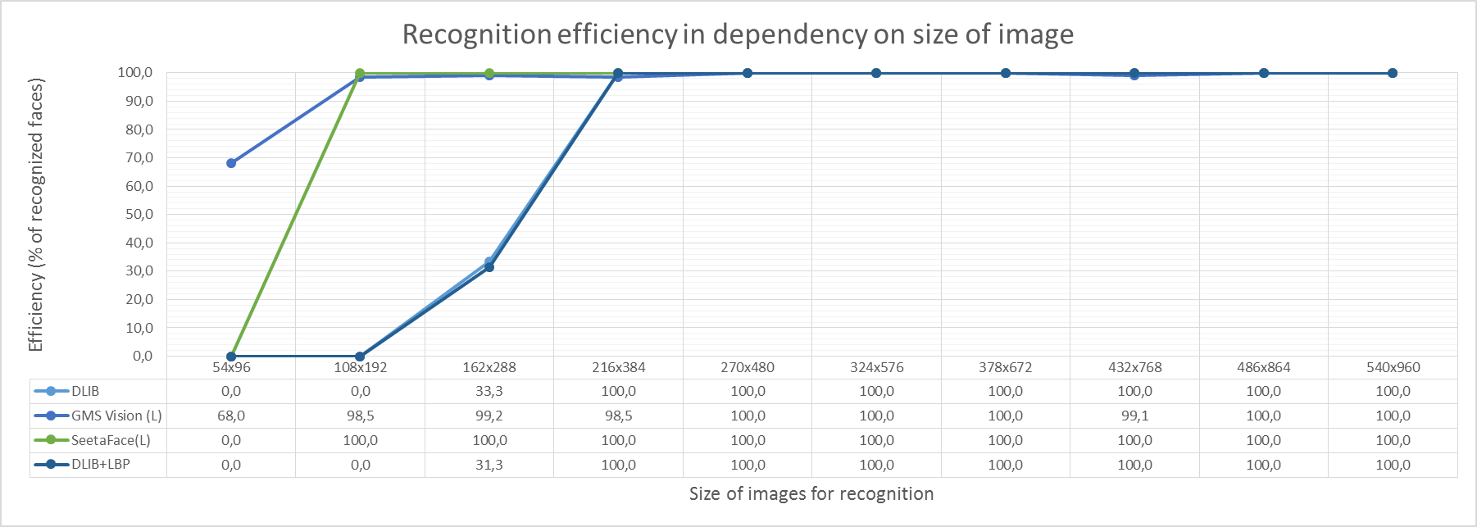
Face Alignment features comparison
Test video file: Accuracy
Also not all detectors shows the same accuracy on the same video file.

Slide 21
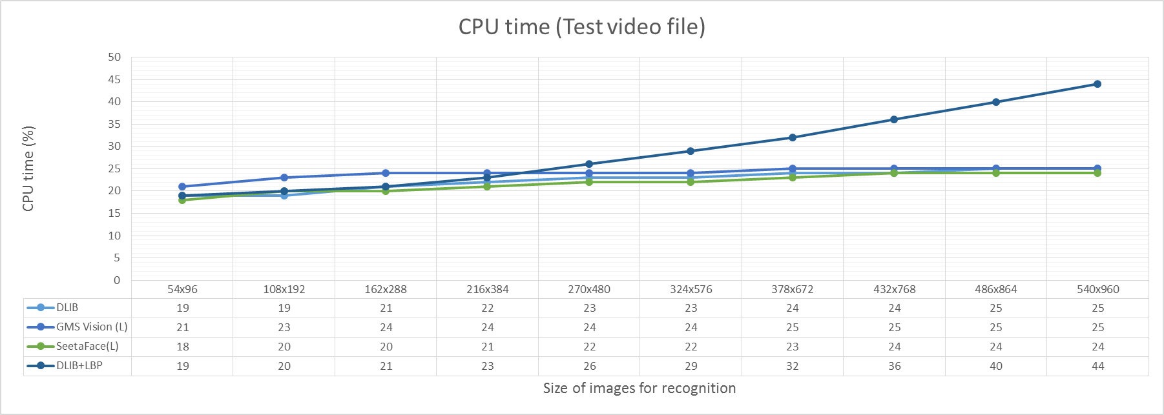
Face Alignment features comparison
Test video file: CPU Consumption
The following diagram shows CPU Time of Test Application for test video file and different frame sizes

Slide 22
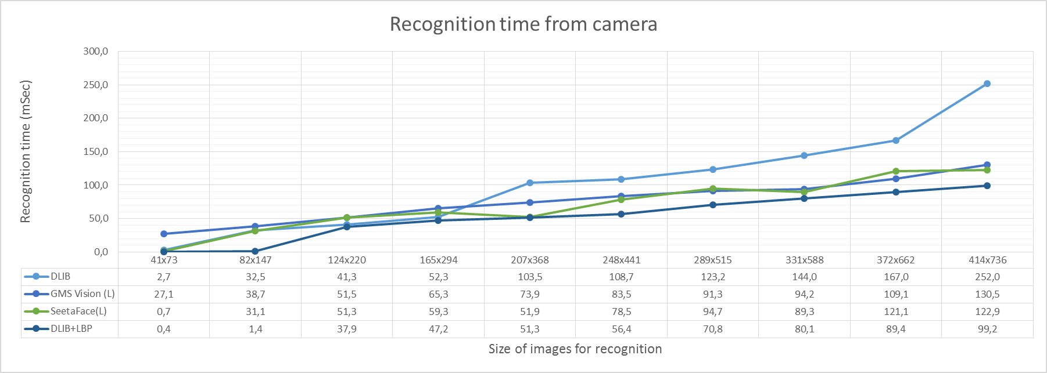
Face Alignment features comparison
Frontal camera: Latency
It is very hard to make identical conditions for measurements while camera is used. So, the following diagram is just for visual comparison.

Slide 23
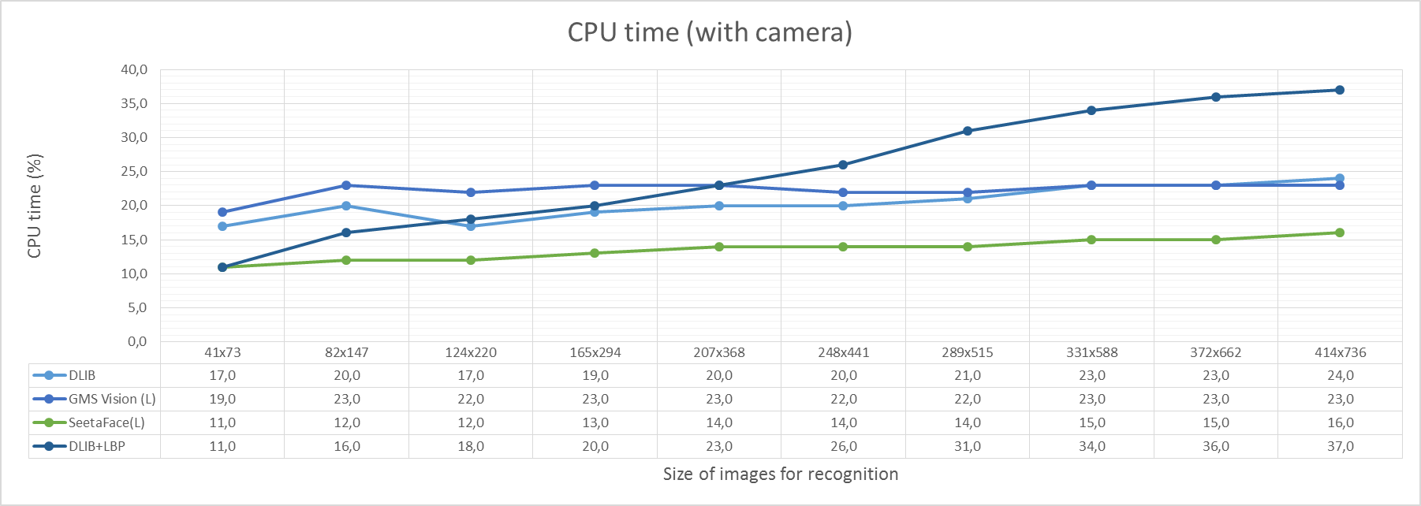
Face Alignment features comparison
Frontal camera: CPU Consumption
The following diagram shows CPU Time of Test Application for different sizes of frames

Slide 24
Conclusion
(TBD)

